Slide 1
Selective Neighbor Caching
George Xylomenos, MMLAB@AUEB
(Work by Xenofon Vasilakos)
PURSUIT/COMET Workshop

Slide 2
Introduction: Mobile ICN and SNC

Slide 3
Why mobile ICN?
Pub/Sub ICN is inherently mobile-friendly
Asynchronous, receiver-driven, split identifier-locator
Mobile re-subscribes after handoff
Resolution takes place
A new publisher sends data (anycast)
Domain A
Domain B
Publisher
Publisher

Slide 4
Why mobile ICN?
IP is inherently mobile-unfriendly
Mobiles have location-bound IP addresses
IP addresses cannot really move
Mobile IP just hides this fact behind tunnels
Naming data makes a big difference
In ICN you can re-subscribe after a handoff
With TCP/UDP you need to resynchronize
Applications must become mobility-aware

Slide 5
Why SNC?
Being mobile-friendly is not enough
Re-subscribing takes time in practice
Subscriptions need to be resolved again
Mobiles with delay requirements need help
Streaming media requires quick resumes
Alerts need to be reliably delivered
Scope of our work
Any kind of mobile software and/or node
Focus on subscribers, not publishers

Slide 6
Why SNC?
Publisher
Subscription pre-caching
Uses mobility proxies
Extra buffer space
Reduced delay
Caching everywhere?
Exhausts buffers
Increases average delay
Select some neighbors
J: Set of neighbors
Proxy:
Cache with mobility support mechanisms
Proxy:
Cache with mobility support mechanisms

Slide 7
Why SNC?
Selective Neighbor Caching (SNC)
Pre-caches subscriptions at selected neighbors
Designed specifically for pub/sub ICN
No changes to pub/sub model
Just needs to know a mobile’s subscriptions
Selected neighbors know what will be requested
Lightweight solution
Exploits any mobility prediction data available
Data are only cached during handoffs

Slide 8
Flat Selective Neighbor Caching

Slide 9
Main Concept
Select an optimal subset of neighboring proxies
Notify them to cache the mobile’s subscriptions
Data starts flowing at selected neighbors on handoff
On handoff completion data stops flowing
Repeat from new proxy
Current Proxy:
S: Subset of neighbor
proxies
i
j
Mobile User

Slide 10
Terminology
Chit: Delay cost for a selected proxy
Which pre-caches data
Current Proxy:
i
j
Mobile User

Slide 11
Terminology
Chit: Delay cost for a selected proxy
Cmiss: Delay cost for an unselected proxy
Which requests data anew
Current Proxy:
i
j
Mobile User

Slide 12
Terminology
Chit: Delay cost for a selected proxy
Cmiss: Delay cost for an unselected proxy
Ccache: Cost for allocating buffer space
Current Proxy:
i
j
Mobile User

Slide 13
Terminology
Chit: Delay cost for a selected proxy
Cmiss: Delay cost for an unselected proxy
Ccache: Cost for allocating buffer space
Pij: Probability that the mobile moves from i to j
Current Proxy:
i
Pij
j
Mobile User

Slide 14
Optimization Goal
Discover which minimizes the total cost:
Costs refer to a common (e.g. monetary) unit: How much am I willing to pay in memory in order to gain in terms of delay?

Slide 15
Distributed Implementation
Each neighbor decides autonomously
May use different cache and delay costs
Cache at in neighbor j if and only if:

Slide 16
Cache Cost
ρ_{util} is cache utilization at the current proxy
α is set to adjust the desired cache utilization
Cache cost depends on cache utilization:

Slide 17
SNC Advantages
SNC is easy to implement
No change to pub/sub ICN model
Fully decentralized decision making
SNC does not waste resources
Only a subset of neighbors are selected
Only subscriptions are cached
Data are cached only during handoff
Improved buffer management means less delay

Slide 18
Hierarchical Selective Neighbor Caching

Slide 19
Why Flat SNC is not enough?
What happens on a miss?
Unselected proxies fall back to the publisher
Why not fetch data from selected neighbors?
The neighbors should advertise cached data
Considerable overhead for questionable gain
i
j

Slide 20
Why Flat SNC is not enough?
Why not optimize across all proxies?
Selected proxies serve data directly
Unselected proxies fall back to their neighbors
This is the Data Placement Problem (DPP)
Unfortunately it is APX-Hard!
Essentially NP-Hard
And the solution may not even be optimal!
Are neighbors always cheaper than the publisher?

Slide 21
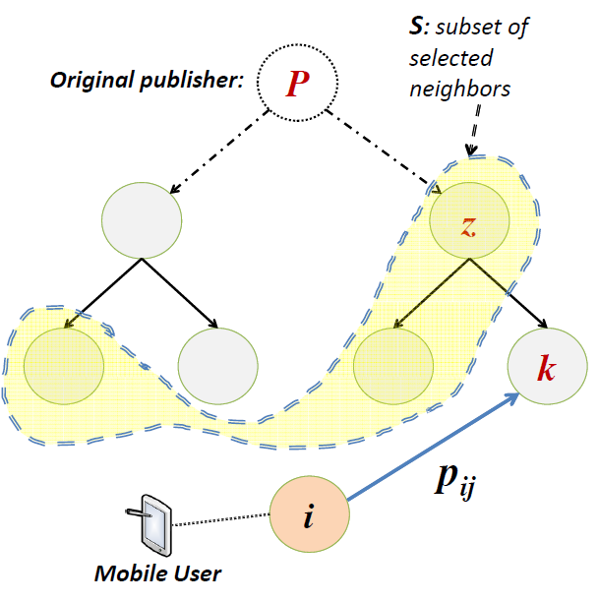
Hierarchical SNC
Flat SNC ignores network structure!
Mobile access networks are (mostly) hierarchical
Why not cache data at higher levels?
This would allow quicker response on misses
A higher level cache serves many children

Slide 22
Hierarchical SNC
Hierarchical SNC reformulates the problem
Assume a hierarchy of proxies
Select a subset to cache subscriptions
Subscriptions move up the hierarchy
This is the natural way to resolve them
No need to advertise cached data
The first cache to be hit will serve the mobile
Higher level caches introduce higher delay
But they also cover more lower level proxies

Slide 23
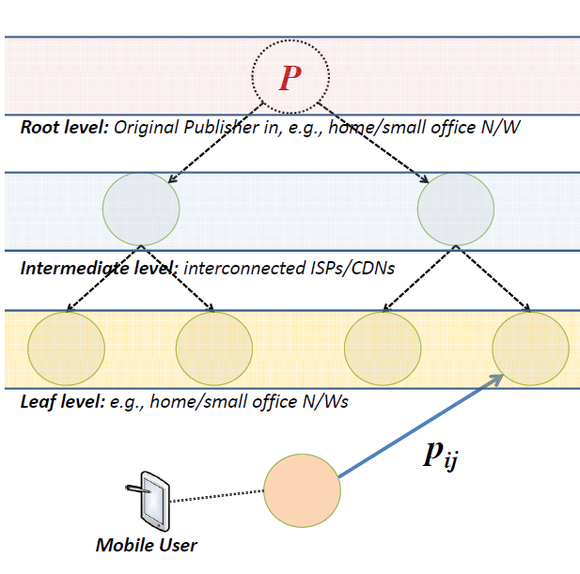
Hierarchical SNC

Slide 24
Challenges posed
In fSNC each proxy decides for itself
These decisions do not affect each other
Each proxy can use its own cache cost metric
In hSNC caching decisions are intertwined
Higher level proxies influence lower level ones
The cost function needs to account for that
A supply and demand formulation can be used
But the problem then becomes hard to solve
It becomes an Oregon knapsack (NP complete!)

Slide 25
Hierarchical <> Co-operative
Is hSNC a variant of co-operative caching?
Cooperative caching is not effective
Due to skewed popularity distribution of data
hSNC is another matter altogether
Data are only cached following subscriptions
Hence popularity does not make a difference
Data are only cached for short periods of time
Hence replacement policies are trivial

Slide 26
Conclusion

Slide 27
Conclusion
SNC enhances mobility in ICN
Mobiles with delay and reliability constraints
Simple and lightweight solution
No changes to existing architecture
Two SNC variants proposed
Flat: leads to decentralized solution
Not necessarily optimal
Hierarchical: mathematically more complex
But the potential gains are higher

