Slide 1
Delivering Stories with Pursuit
Story-delivery presentation and demo
Ben Tagger and Dirk Trossen (UCAM)
Stuart Porter (CTVC)

Slide 2
What are we doing today?
Present the middleware design (briefly!)
Present the story-delivery design (briefly!)
What are these EDL things?
Demo: Investigating network resources.
Demo: Modelling EDLs within our network.
Demo: Building and disseminating multi-version media.

Slide 3
Why are we building ICN middleware?
To help demonstrate the efficacy of our network from the application layer.
To provide solutions for a publish-subscribe networking paradigm (i.e., How do I get data if I don’t know where/what it is?)
To illustrate the reduction of complexity of the required middleware layer when using compatible constructs (e.g. ontologies).
We want to build larger systems – Middleware promotes Integration – Integration enables the building of large-scale systems.
Notes:
So, we’re asking the questions,
2 – what are the natural benefits of using ICN that we can see from the application layer?
3 – What abstractions can we provide to facilitate interaction with an ICN layer?
4 - Finally, we want to build larger systems – this is the fundamental reason behind middleware.

Slide 4
What is an Ontology?
A model for describing the world (a domain).
Represents domain knowledge as sets of concepts.
You can define relationships between the concepts.
An ontology is an abstract term.
We use the Web Ontology Language (OWL).
Based on XML/RDF (RDF-s).
We have reasoners to ensure that our ontologies are consistent. Concepts/relationships do not contradict one another.
Notes:
We tend to use the term “ontological middleware”, which can freak people out. Here’s a quick note on ontologies.

Slide 5
Publishing: From Start to Finish
S₀
S₁
S_{n}
?
…
annotate
Network
Σ(S)
Min(S)
media
merge
prune
map
publish
P
P

Slide 6
Advantages of Publishing in this way
Formal Metamodelling: we propose a formal specification of all data/metadata that enters our network. We can check consistency at the network level.
Semantically-enriched publications: Every piece of networked data is described with consistent metadata (what other system can make that boast?).
Easily Expandable: New features can easily be represented using this system. Just add a new (or update an existing) ontology that encapsulates the new features as concepts.
Notes:
is consistency of the network information space.
is consistency of the publications.
You can then start annotating your publications with these new feature concepts.

Slide 7
Subscribing
Before:
Know the ID and then subscribe to it.
Subscribe using pre-known IDs from catalogs.
After:
Extending the catalog design with data browsing.
Subscribing with search criteria (querying).
Simple mechanisms.
This occurs without altering any part of the core functions.

Slide 8
Browsing…
View from subscriber
Network metamodel
catalog
s1
s1
s2
s3
s2
s3
r1
s4
s5
r2
r1
s4
s5
r3
r4
r2
r3
r4
= metadata item

Slide 9
Searching/Querying…
Scope of interest
query!
query!
A
publish
(id, query)
S_{Q}
subscribe
S_{A}
generate
answer
results
results
B
subscribe
publish(id, answer)

Slide 10
Delivering Media the Old (current) Way…

Slide 11
Media Repository
media
media
Server
Client
network

Slide 12
Delivering Media the ICN Way…!

Slide 13
Pursuit…
Blackadder…
Dissemination…
HD subscription
(EDL)
Video…
over 18
UCAM Summer School Promo
SDN (Player)
Middleware/
Blackadder/
Publishers
query
Notes:
Remember back to Stuart’s slide on personalisation – implicit and explicit metadata.

Slide 14
Clip #1: [source_media] [start_time] [end_time]
clip 1 metadata
Clip #2: [source_media] [start_time] [end_time]
clip 2 metadata
UCAM Summer School Promo
Clip #N: and so on…..
clip N metadata
programme metadata
check for consistency
Notes:
When a film is produced in an edit suite, the system is able to output an Edit Decision List (EDL).
EDL includes data such as clip number, file location, in-points and out-points which help the system identify a part of the film.
SDN is a layer which sits on top of the editing process and uses the EDL to…

Slide 15
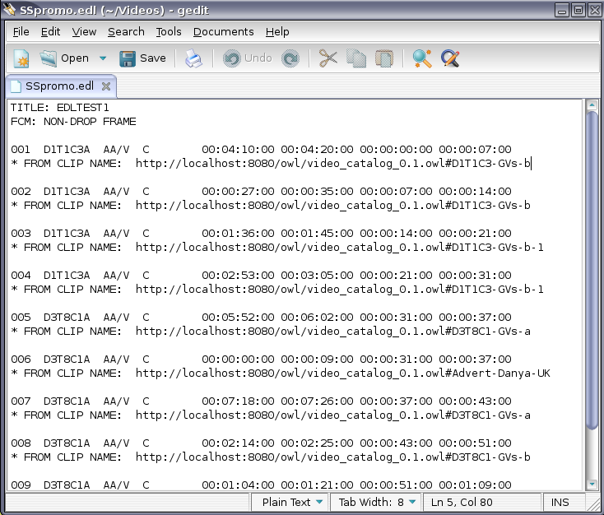
The Edit Decision List (EDL)
Notes:
What is the complexity of this as an authoring tool?

Slide 16
EDL Demo.
Disney employees, look away now…
Passive vs. Active

Slide 17
media
media
Publisher
Subscriber
Publisher
Media Repository
Publisher
Publisher
Media Repository
Media Repository
Media Repository

Slide 18
Promo Demo.
Sample programming with UK & US versions.

Slide 19
Thanks for Listening..!

